Slide 1
UPPER SIXTH ARTS
GEOGRAPHY
Lesson 9
New Industrial Strategy for Development
Notes:
Good morning, class, and welcome to our geography lesson. I am your geography teacher, Mr Kamdem. Today we are starting Lesson 9: New Industrial Strategy for Development.

Slide 2
CLASS INFO
Class, Chapter and Duration
Class | Upper Sixth Arts
Chapter | Module 7: Understanding and managing contemporary environmental and development issues
Duration | 2 periods (2 × 50 minutes)
Notes:
This lesson is for Upper Sixth Arts. It belongs to Module 7: Understanding and managing contemporary environmental and development issues. We shall need 2 periods to cover it.

Slide 3
IDENTIFICATION
Lesson Identification
Topic | Current Development Issues
Sub-topic | Global Strategies to Redress Underdevelopment
Lesson | Lesson 9: New Industrial Strategy for Development
Notions / Concepts | Newly industrialised country (NIC), Asian tigers, export-led growth, enabling environment, free zone.
Syllabus focus | Meaning of NICs; classification (generations); strategies used by NICs (enabling environment).
Competence | Learners are able to explain how NICs developed and what Cameroon can learn from them.
Notes:
Our topic is Current Development Issues, and the sub-topic is Global Strategies to Redress Underdevelopment. The key notions we shall use today are: newly industrialised country (NIC), Asian tigers, export-led growth, enabling environment, free zone. At the end, you should be able to do this: learners are able to explain how NICs developed and what Cameroon can learn from them.

Slide 4

HOMEWORK CORRECTION
Correction of the Homework
Question (Lesson 8: Strategies of Development):
Choose one SDG and describe what your community does to achieve it.
Notes:
Before we start the new lesson, let us correct the homework I gave you at the end of Lesson 8: Strategies of Development. The question was: Choose one SDG and describe what your community does to achieve it. Take out your exercise books.

Slide 5
HOMEWORK CORRECTION
Correction: Possible Answer
Example: SDG 6 (clean water). The community has dug wells and a borehole with help from the council, a water committee collects small fees for repairs, and people are taught to treat water.
Notes:
Here is a good answer. Example: SDG 6 (clean water). The community has dug wells and a borehole with help from the council, a water committee collects small fees for repairs, and people are taught to treat water. Compare it with your own answer and correct your work in red.

Slide 6
LESSON PLAN
Lesson Plan
Correction of the homework
Objectives and recall
Real-life situation and action to take
Learning activities
Board summary
Evaluation, remediation and homework
Notes:
Here is the plan of our lesson today. First, we shall correct the homework. Then we shall look at the objectives and recall what you already know. After that, we shall study a situation from real life and the action to take, and do the learning activities. Finally, we shall copy the board summary, do the evaluation and the remediation, and I will give you the homework.

Slide 7
OBJECTIVES
Objectives
By the end of this lesson, you should be able to:
Define an NIC and give examples.
Classify NICs into generations.
Explain the strategies of NICs.
Notes:
By the end of this lesson, you should be able to do three things. Number 1: define an NIC and give examples. Number 2: classify NICs into generations. Number 3: explain the strategies of NICs.

Slide 8
PREVIOUS KNOWLEDGE
Previous Knowledge
Industry creates jobs and wealth.
Many electronics come from Asia.
Notes:
Let us first remember what you already know. Industry creates jobs and wealth. Many electronics come from Asia. Keep this in mind, because we shall build on it today.

Slide 9
REAL-LIFE SITUATION
Situation in Real Life
In 1960, South Korea was as poor as many African countries. Today it makes phones, cars and ships sold in Cameroon. Students wonder how it developed so fast.
Notes:
Listen carefully to this situation from real life. In 1960, South Korea was as poor as many African countries. Today it makes phones, cars and ships sold in Cameroon. Students wonder how it developed so fast. Think about it, because I am going to ask you some questions.

Slide 10
REAL-LIFE SITUATION
Situation: Question 1
What is the problem in the situation?
Notes:
Question 1: What is the problem in the situation? Think for a moment, then raise your hand to answer.

Slide 11
REAL-LIFE SITUATION
Answer
Why some poor countries developed fast.
Notes:
Good. Why some poor countries developed fast.

Slide 12
REAL-LIFE SITUATION
Situation: Question 2
What are such countries called?
Notes:
Question 2: What are such countries called? Think for a moment, then raise your hand to answer.

Slide 13
REAL-LIFE SITUATION
Answer
Newly industrialised countries (NICs).
Notes:
Good. Newly industrialised countries (NICs).

Slide 14
REAL-LIFE SITUATION
Situation: Question 3
Give one product they export.
Notes:
Question 3: Give one product they export. Think for a moment, then raise your hand to answer.

Slide 15
REAL-LIFE SITUATION
Possible Answer
Phones (or cars, ships).
Notes:
Good. Phones (or cars, ships).

Slide 16
ACTION TO TAKE
Action to Take
Learn technical skills that help industry to grow.
Notes:
From this situation, the action we are working towards in this lesson is the following: learn technical skills that help industry to grow.

Slide 17
JUSTIFICATION
Justification of the Lesson
This lesson helps us to learn from countries that industrialised quickly.
Notes:
Why is this lesson important for you? This lesson helps us to learn from countries that industrialised quickly.

Slide 18
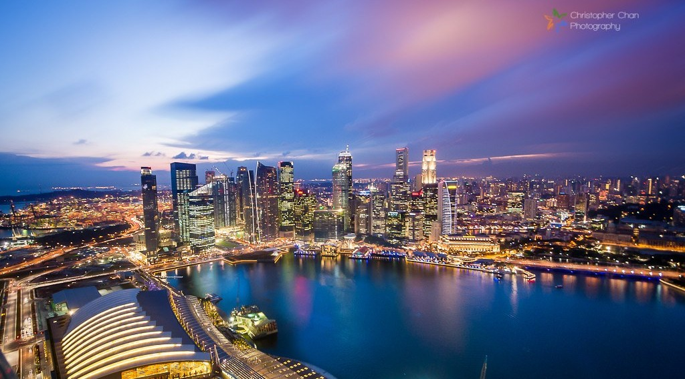
1. MEANING OF NICs
Activity 1
Singapore, an Asian tiger.
Notes:
Activity 1. Look carefully at this picture: singapore, an Asian tiger. Observe every detail before I ask the question.

Slide 19
1. MEANING OF NICs
Activity 1: Question
What is an NIC?
Notes:
Here is the question for Activity 1: What is an NIC? Take one minute to think and write your answer in your rough notebook.

Slide 20
1. MEANING OF NICs
Activity 1: Answer
A country that has industrialised quickly since the 1960s, like South Korea or Singapore.
Notes:
Let us check the answer together. A country that has industrialised quickly since the 1960s, like South Korea or Singapore.

Slide 21
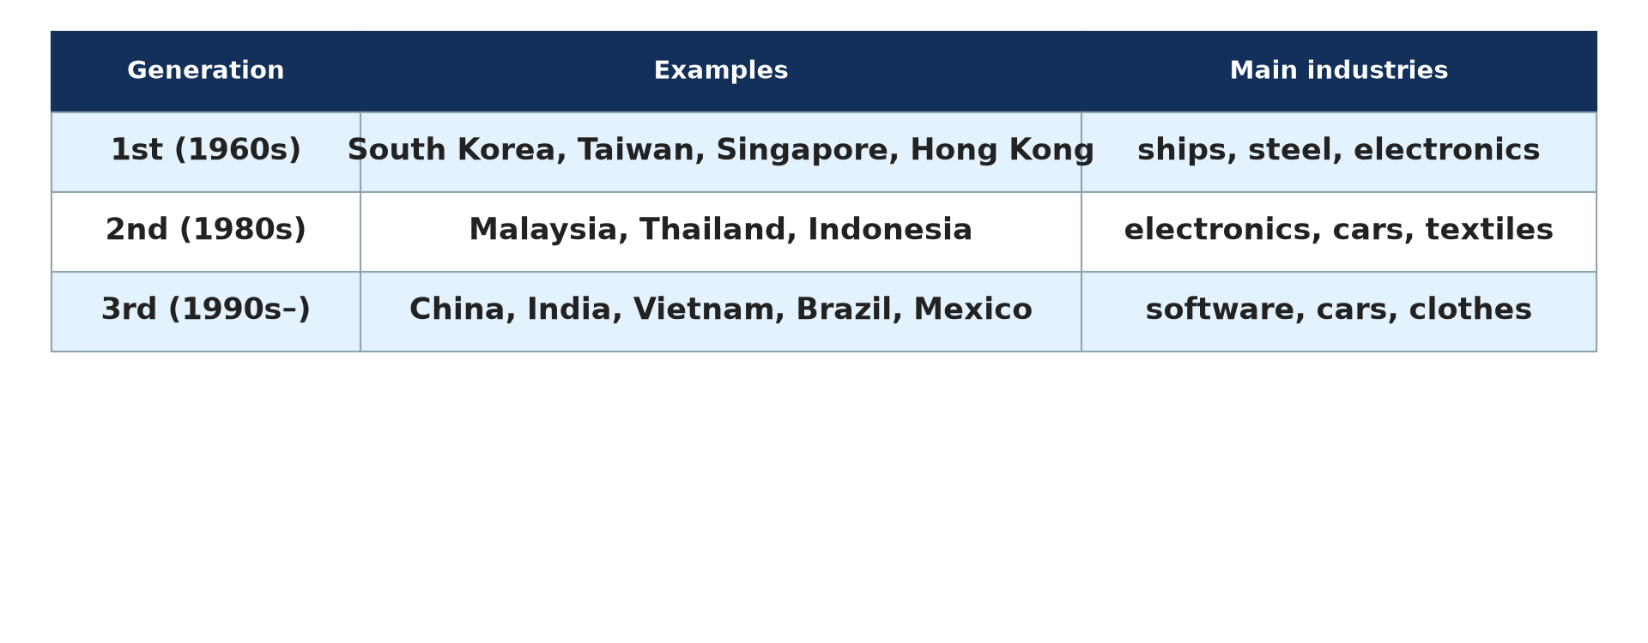
2. CLASSIFICATION OF NICs
Activity 2
Generations of NICs.
Notes:
Activity 2. Look carefully at this diagram: generations of NICs. Observe every detail before I ask the question.

Slide 22
2. CLASSIFICATION OF NICs
Activity 2: Question
Name the four first-generation Asian tigers.
Notes:
Here is the question for Activity 2: Name the four first-generation Asian tigers. Take one minute to think and write your answer in your rough notebook.

Slide 23
2. CLASSIFICATION OF NICs
Activity 2: Answer
South Korea, Taiwan, Singapore and Hong Kong.
Notes:
Let us check the answer together. South Korea, Taiwan, Singapore and Hong Kong.

Slide 24

2. WORLD PATTERN
Activity 3
Old and new industrial regions.
Notes:
Activity 3. Look carefully at this diagram: old and new industrial regions. Observe every detail before I ask the question.

Slide 25
2. WORLD PATTERN
Activity 3: Question
Where are most NICs located?
Notes:
Here is the question for Activity 3: Where are most NICs located? Take one minute to think and write your answer in your rough notebook.

Slide 26
2. WORLD PATTERN
Activity 3: Answer
In East and South-East Asia (also Brazil and Mexico).
Notes:
Let us check the answer together. In East and South-East Asia (also Brazil and Mexico).

Slide 27
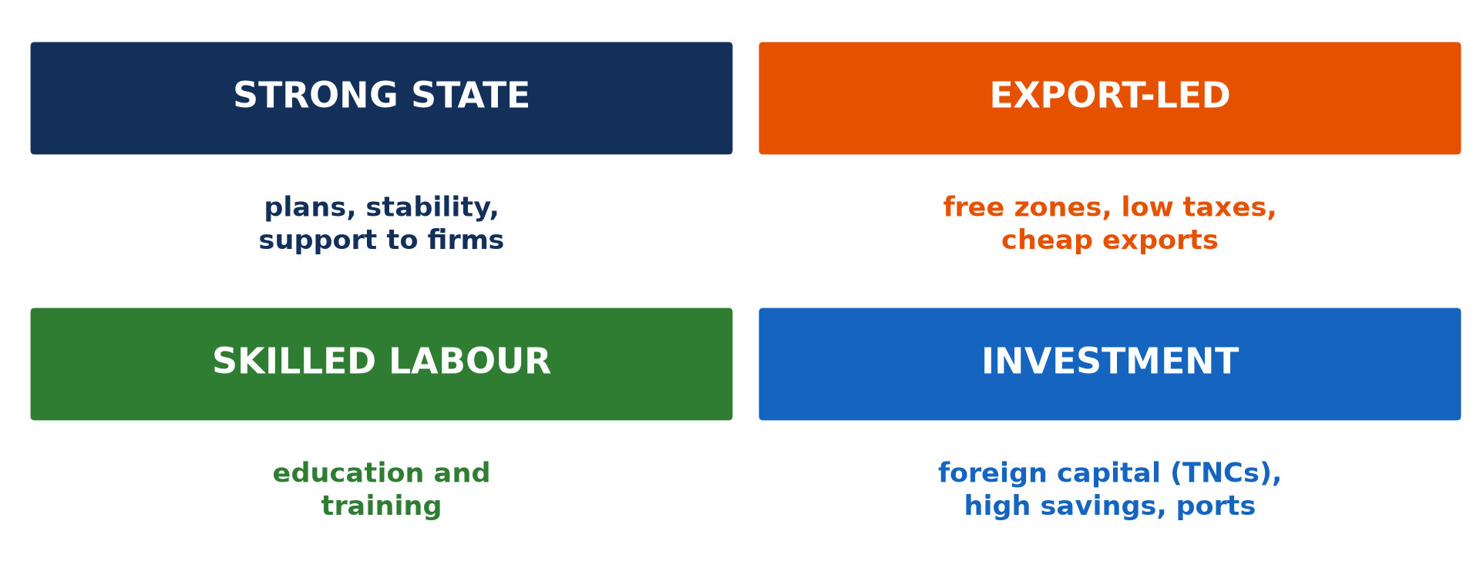
3. STRATEGIES OF NICs
Activity 4
Strategies of NICs.
Notes:
Activity 4. Look carefully at this diagram: strategies of NICs. Observe every detail before I ask the question.

Slide 28
3. STRATEGIES OF NICs
Activity 4: Question
Give three strategies used by NICs.
Notes:
Here is the question for Activity 4: Give three strategies used by NICs. Take one minute to think and write your answer in your rough notebook.

Slide 29
3. STRATEGIES OF NICs
Activity 4: Answer
Strong state support, export-led growth and education (also foreign investment).
Notes:
Let us check the answer together. Strong state support, export-led growth and education (also foreign investment).

Slide 30
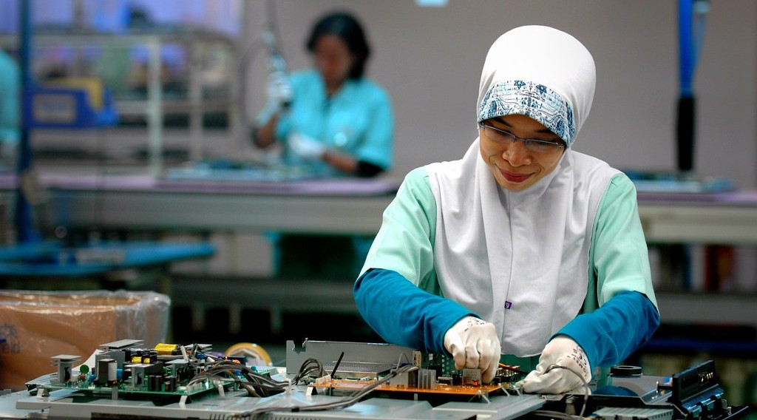
3. EXPORT INDUSTRIES
Activity 5
Workers in an electronics factory.
Notes:
Activity 5. Look carefully at this picture: workers in an electronics factory. Observe every detail before I ask the question.

Slide 31
3. EXPORT INDUSTRIES
Activity 5: Question
Why did NICs start with labour-intensive industries?
Notes:
Here is the question for Activity 5: Why did NICs start with labour-intensive industries? Take one minute to think and write your answer in your rough notebook.

Slide 32
3. EXPORT INDUSTRIES
Activity 5: Answer
They had cheap, hard-working labour but little capital.
Notes:
Let us check the answer together. They had cheap, hard-working labour but little capital.

Slide 33
BOARD SUMMARY
Board Summary
Topic: Current Development Issues
Sub-topic: Global Strategies to Redress Underdevelopment
Lesson 9: New Industrial Strategy for Development
Notes:
Now we are going to copy the board summary. Write the title and the headings neatly in your notebooks. I will give you enough time for each slide, so do not rush.

Slide 34
BOARD SUMMARY
1. Meaning of NICs
Newly industrialised countries can be defined as follows:
NIC: It is a country that has changed quickly from farming to industry since the 1960s. Its exports are mainly manufactured goods.
Notes:
Let us copy Meaning of NICs. Newly industrialised countries can be defined as follows. On this slide we have NIC. Write each point on a new line, with the key term first, and explain it in your own words when we revise. When you finish, we go to the next slide.

Slide 35
BOARD SUMMARY
1. Meaning of NICs (continued)
Export-led growth: It is growth based on producing goods for sale abroad. NICs used it instead of producing only for the home market.
Notes:
We continue with Meaning of NICs. On this slide we have Export-led growth. Write each point on a new line, with the key term first, and explain it in your own words when we revise.

Slide 36
BOARD SUMMARY
2. Classification of NICs
NICs are classified into generations:
First generation: South Korea, Taiwan, Singapore and Hong Kong grew from the 1960s. They are called the Asian tigers.
Notes:
Let us copy Classification of NICs. NICs are classified into generations. On this slide we have First generation. Write each point on a new line, with the key term first, and explain it in your own words when we revise. When you finish, we go to the next slide.

Slide 37
BOARD SUMMARY
2. Classification of NICs (continued)
Second and third generations: Malaysia, Thailand and Indonesia followed in the 1980s, then China, India and Vietnam. Brazil, Mexico and South Africa are also classed as NICs.
Notes:
We continue with Classification of NICs. On this slide we have Second and third generations. Write each point on a new line, with the key term first, and explain it in your own words when we revise.

Slide 38
BOARD SUMMARY
2. Classification of NICs
Illustration: generations of NICs
Notes:
Now draw this illustration in your notebook: generations of NICs. Give it a title and label it clearly.

Slide 39
BOARD SUMMARY
3. Strategies of NICs (Enabling Environment)
NICs developed through the following strategies:
Government and infrastructure: Strong and stable governments planned industry and built ports, roads and power stations. They protected young industries at first.
Notes:
Let us copy Strategies of NICs (Enabling Environment). NICs developed through the following strategies. On this slide we have Government and infrastructure. Write each point on a new line, with the key term first, and explain it in your own words when we revise. When you finish, we go to the next slide.

Slide 40
BOARD SUMMARY
3. Strategies of NICs (Enabling Environment) (continued)
Human resources: Education and training gave a skilled and disciplined workforce. Wages were low at first, which attracted investors.
Notes:
We continue with Strategies of NICs (Enabling Environment). On this slide we have Human resources. Write each point on a new line, with the key term first, and explain it in your own words when we revise. When you finish, we go to the next slide.

Slide 41
BOARD SUMMARY
3. Strategies of NICs (Enabling Environment) (continued)
Investment and exports: Free zones and low taxes attracted foreign firms. Industries moved from textiles to electronics, cars and ships as skills grew.
Notes:
We continue with Strategies of NICs (Enabling Environment). On this slide we have Investment and exports. Write each point on a new line, with the key term first, and explain it in your own words when we revise.

Slide 42
BOARD SUMMARY
3. Strategies of NICs (Enabling Environment)
Illustration: strategies of NICs
Notes:
Now draw this illustration in your notebook: strategies of NICs. Give it a title and label it clearly.

Slide 43
FORMATIVE EVALUATION
Evaluation 1
Give three characteristics of NICs.
Notes:
Now let us check what you have understood. Question 1: Give three characteristics of NICs. Answer in your exercise book.

Slide 44
FORMATIVE EVALUATION
Expected Answer
Fast industrial growth, exports and rising incomes.
Notes:
The expected answer is: fast industrial growth, exports and rising incomes. If you got it right, well done.

Slide 45
FORMATIVE EVALUATION
Evaluation 2
Give two strategies of NICs that Cameroon could copy.
Notes:
Now let us check what you have understood. Question 2: Give two strategies of NICs that Cameroon could copy. Answer in your exercise book.

Slide 46
FORMATIVE EVALUATION
Expected Answer
Education of workers and free zones for export industries.
Notes:
The expected answer is: education of workers and free zones for export industries. If you got it right, well done.

Slide 47
REMEDIATION
Remediation
Fill in the blanks:
The first NICs are called the Asian ______.
Growth based on exports is ______-led growth.
Zones with low taxes are ______ zones.
Notes:
For those who need more practice, fill in the blanks in your exercise book. The answers are: number 1, tigers; number 2, export; number 3, free.

Slide 48
HOMEWORK
Homework
Compare South Korea and Cameroon in 1960 and today using two indicators.
Notes:
For your homework: Compare South Korea and Cameroon in 1960 and today using two indicators. We shall correct it at the beginning of our next lesson.

Slide 49
NEXT LESSON
Next Lesson
Our next lesson will be on:
Lesson 10: Globalisation
Notes:
Our next lesson will be on Lesson 10: Globalisation. Thank you for your attention, and see you next time.

Slide 50
BILINGUAL GAME
Bilingual Game (Jeu Bilingue)
English | Français
Newly industrialised country | Le nouveau pays industrialisé
Export | L'exportation
Investment | L'investissement
Skilled worker | L'ouvrier qualifié
Factory | L'usine
Strategy | La stratégie
Notes:
Let us play the bilingual game. I say a word in English, and you give me the French word. Then we do the reverse.

Slide 51
LOGBOOK
Official Logbook (1/2)
Module / Topic | Current Development Issues
Lesson Title | Lesson 9: New Industrial Strategy for Development
Expected Learning Outcomes | Define an NIC and give examples. Classify NICs into generations. Explain the strategies of NICs.
Competence | Learners are able to explain how NICs developed and what Cameroon can learn from them.
Notes:
I record this information in the official logbook of the class after the lesson.

Slide 52
LOGBOOK
Official Logbook (2/2)
Matter Taught | Meaning of NICs; Classification of NICs; Strategies of NICs (Enabling Environment).
Evaluation | Formative evaluation and remediation exercise.
Homework | Compare South Korea and Cameroon in 1960 and today using two indicators.
Enrolment / Present / Absent | ____ / ____ / ____
Achievement | To be completed after the lesson.
Notes:
I complete the second page of the logbook: the matter taught, the evaluation, the homework and the attendance.

Slide 53
TEACHER'S NOTE
Teacher's Note
Timing: Homework correction, plan, objectives 8 min | Recall, situation, action 10 min | 5 activities 30 min | Board summary (copying) 30 min | Evaluation, remediation 10 min | Homework, next lesson 5 min | Logbook 7 min
Without the projector (Activity 1): name NICs.
Without the projector (Activity 2): read the table.
Without the projector (Activity 3): read the map.
Without the projector (Activity 4): list strategies.
Without the projector (Activity 5): discuss cheap labour.
Notes:
This slide is for me, the teacher: it gives the timing of the lesson and what to do if the projector is not available.

Slide 54
REFERENCES
References
National Geography Syllabus, MINESEC/IGE/IP-SS, 2019 — Module 7 (Environment and Development).
Photo, Activity 1: “Singapore” by Christopher Chan, CC BY-NC-ND 2.0, via Flickr (https://www.flickr.com/photos/17751217@N00/8909326546)
Photo, Activity 5: “electronics factory” by ILO in Asia and the Pacific, CC BY-NC-ND 2.0, via Flickr (https://www.flickr.com/photos/77173826@N08/8096445212)
Diagrams and animations: drawn for this lesson (Geography Department).
Notes:
These are the references and picture credits used to prepare this lesson.

